Slide 1


DATA STRUCTURES AND APPLICATIONS LABORATORY
By,
LIKITHA.D
ASSISTANT PROFESSOR
DEPT OF CSE-AI&ML
ATMECE,MYSURU
DEPARTMENT OF CSE-AI&ML

Slide 2
1. Importance of Data Structures Lab
You have already started learning the theoretical concepts of Data Structures in your regular classes.
Theory gives us the knowledge of what a data structure is, what operations can be performed, and how efficiently those operations can be carried out.
But the lab is where we apply these concepts practically and see how they actually work.
In the lab, you will write programs, execute them, identify errors, debug the programs, and understand what happens behind the code.
You will learn not only what the program does, but also why and how it works.
So, I want you to consider the lab as a place where you learn by doing.
DEPARTMENT OF CSE-AI&ML

Slide 3
2. Why is Data Structures Important?
Data Structures is one of the most important foundation subjects in Computer Science and AI & ML.
Whenever we develop an application, work with a database, process large amounts of data, or build an AI/ML system, we need to store and organize data efficiently.
For example:
If we have a small amount of data, almost any method may appear to work.
But when the amount of data becomes very large, choosing the right data structure becomes extremely important.
The right data structure can make a program faster, more efficient, and easier to manage.
Concepts such as arrays, stacks, queues, linked lists, trees, and searching and sorting techniques are used as building blocks in many real-world applications.
DEPARTMENT OF CSE-AI&ML

Slide 4
3. Connection Between Theory and Lab
Your theory and laboratory sessions are closely connected.
For example:
When you learn Arrays in theory, you will implement array operations in the lab.
When you study Stacks, you will write programs for stack operations and applications.
When you learn Queues, you will implement insertion and deletion operations.
Similarly, you will practically implement other data structures and understand their operations.
So, please do not treat theory and lab as two separate subjects.
👉 Theory tells you the concept.
👉 Lab teaches you how to implement that concept.
Both are equally important.
DEPARTMENT OF CSE-AI&ML

Slide 5
4. What Will You Learn in the Lab?
During this laboratory course, you will develop your programming and problem-solving skills through practical implementation.
You will learn:
Arrays and Structures
Pointers and Dynamic Memory Allocation
Stacks
Queues
Linked Lists
Trees
Searching and Sorting concepts
Implementation of different data structures using C programming
Debugging and error identification
Understanding program output and analyzing the results
More importantly, you will develop logical thinking and problem-solving skills
DEPARTMENT OF CSE-AI&ML

Slide 6
5. Lab Session Structure
Each week, you will have your scheduled Data Structures Lab session.
During the lab, we will generally follow these steps:
Understand → Write → Execute → Debug → Analyze → Record
For every experiment:
First, understand the problem statement.
Understand the algorithm and logic.
Write the program.
Compile and execute the program.
Test it with different inputs.
Identify and correct errors.
Analyze the output.
DEPARTMENT OF CSE-AI&ML

Slide 7
Course Learning Objectives:
CO1: Understand and implement fundamental data structures and their operations using C.
CO2: Select and apply appropriate data structures for solving computational and real-world problems.
CO3: Develop systematic documentation and technical reporting of laboratory experiments and their outcomes.
DEPARTMENT OF CSE-AI&ML

Slide 8
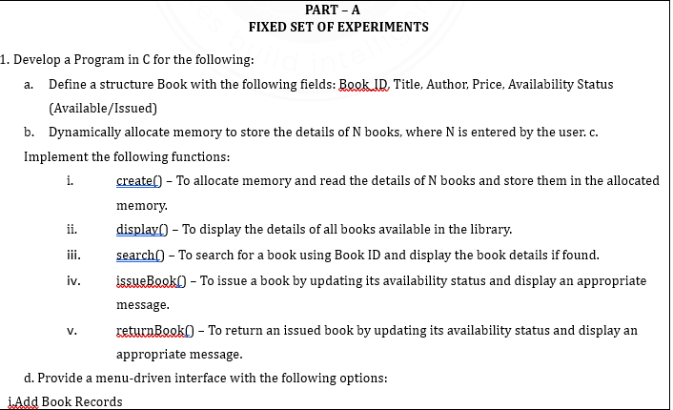
LABORATORY EXPERIMENTS
DEPARTMENT OF CSE-AI&ML

Slide 9
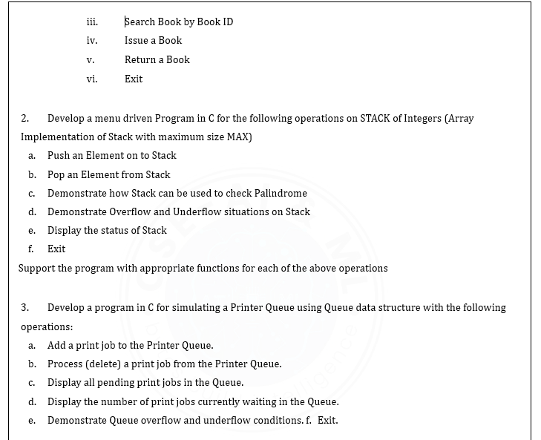
DEPARTMENT OF CSE-AI&ML

Slide 10
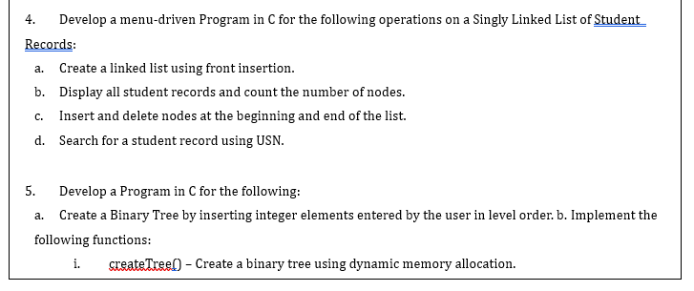
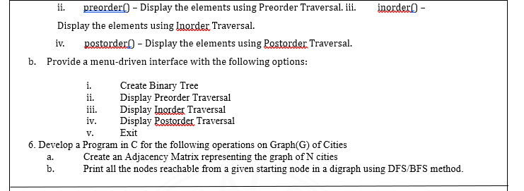
DEPARTMENT OF CSE-AI&ML

Slide 11
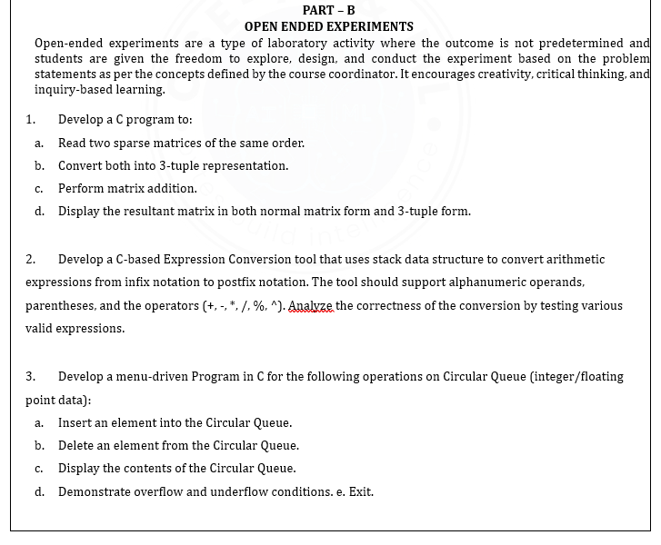
DEPARTMENT OF CSE-AI&ML

Slide 12
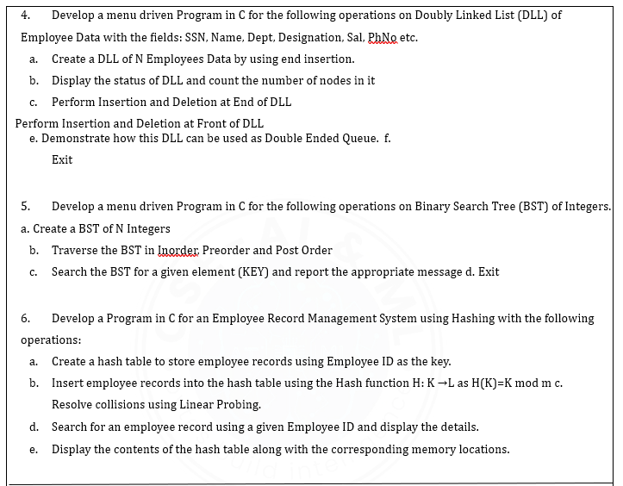
DEPARTMENT OF CSE-AI&ML

Slide 13
Course outcome (Course Skill Set)
At the end of the course, the student will be able to:
1.Develop C programs to implement fundamental data structures and their operations for solving computational problems.
2.Make use of appropriate data structures to organize, store, and manipulate data for solving real-world problems using C.
3.Build a laboratory record consisting of problem statements, algorithm/design, implementation, program outputs, and result with appropriate inferences.
DEPARTMENT OF CSE-AI&ML

