Slide 1
Project Management with Git-1BCSL307A
INTRODUCTION TO THE LAB
Dr Hussana Johar R B
Associate professor
CSE(Ai\I&ML),ATMECE,Mysore

Slide 2
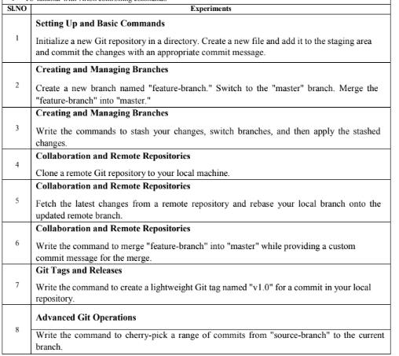

Slide 3
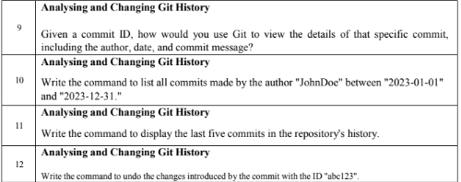

Slide 4
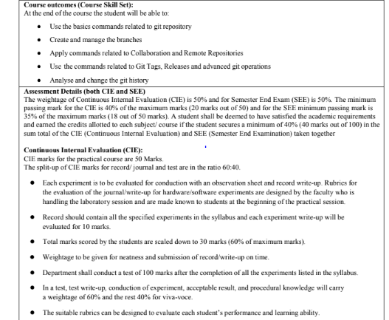

Slide 5
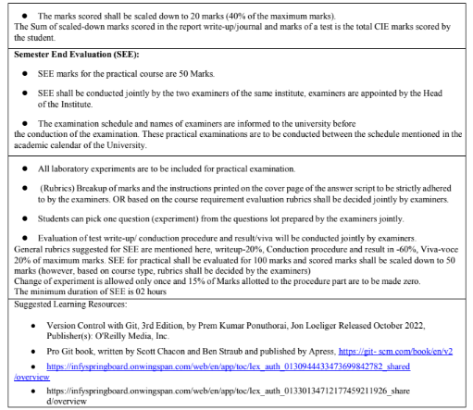

Slide 6
1. GIT BASICS
Git is a distributed version control system (VCS) that is widely used for tracking changes in source
code during software development. It was created by Linus Torvalds in 2005 and has since become
the de facto standard for version control in the software development industry.
Git allows multiple developersto collaborate on a project by providing a history of changes, facilitating
the tracking of who made what changes and when. Here are some key concepts and features of Git:
1. Repository (Repo): A Git repository is a directory or storage location where your project's files
and version history are stored. There can be a local repository on your computer and remote
repositories on servers.
2. Commits: In Git, a commit is a snapshot of your project at a particular point in time. Each
commit includes a unique identifier, a message describing the changes, and a reference to the
previous commit.
3. Branches: Branches in Git allow you to work on different features or parts of your project
simultaneously without affecting the main development line (usually calledthe "master"
branch). Branches make it easy to experiment, develop new features, andmerge changes back
into the main branch when they are ready.
4. Pull Requests (PRs): In Git-based collaboration workflows, such as GitHub or GitLab, pull
requests are a way for developers to propose changes and have them reviewed by their peers.
This is a common practice for open-source and team-based projects.

Slide 7
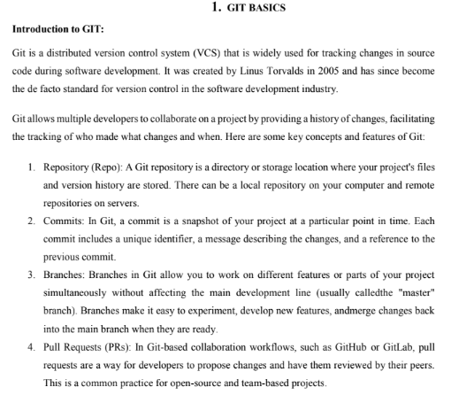

Slide 8
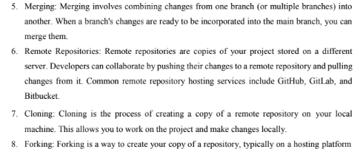

Slide 9
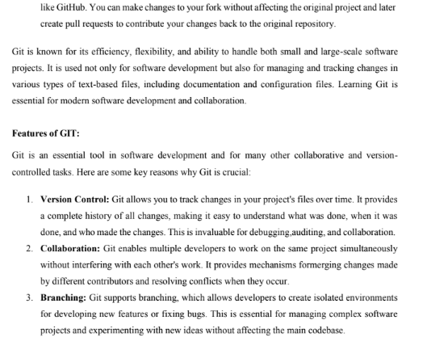

Slide 10
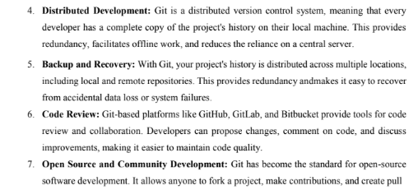

Slide 11
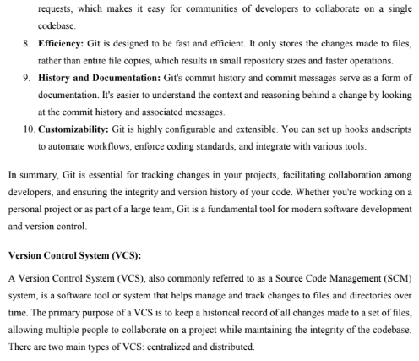

Slide 12
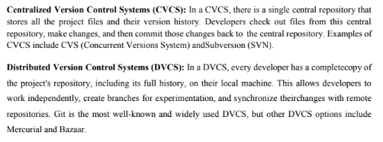

Slide 13
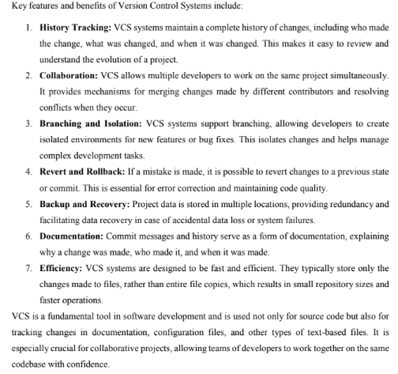

Slide 14
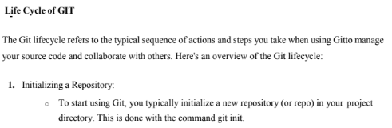

Slide 15
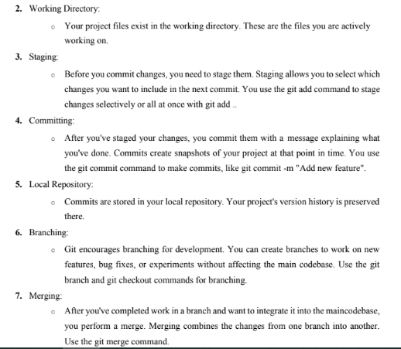

Slide 16
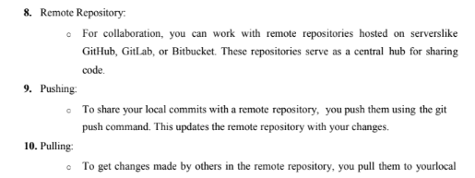

Slide 17
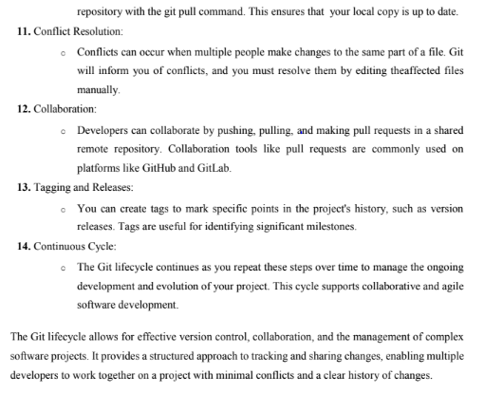

Slide 18
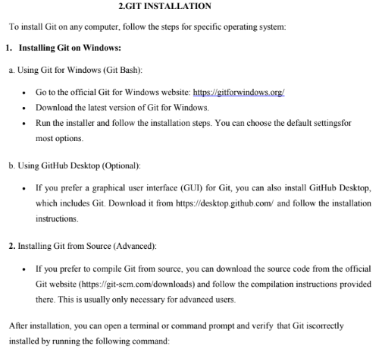

Slide 19
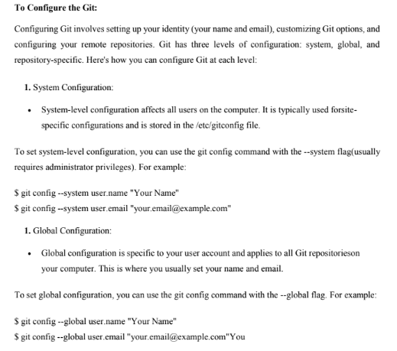

Slide 20
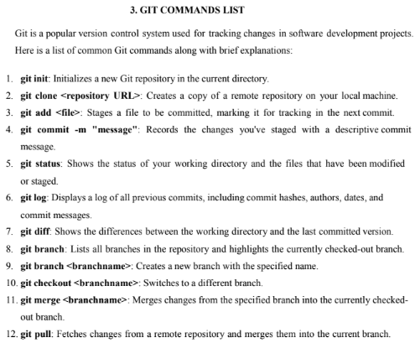

Slide 21
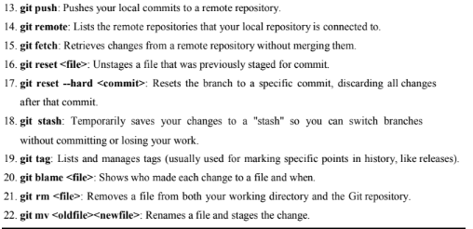

Slide 22
THANK YOU

