Slide 1
Course Name
DATA STRUCTURES AND APPLICATIONS
Course Code
1BCS305
Course Coordinator
Contact Hours
50
Dr.Neethi M V
Assistant Professor
Dept of CSE-DS
ATMECE, Mysuru
CIE Marks
50
SEE Marks
50

Slide 2
INTRODUCTION TO DATA STRUCTURES
Module 1
Dr.Neethi M V
Assistant Professor
Dept of CSE-Data Science
ATMECE

Slide 3
Course Outcomes
CO 1. Explain different data structures and their applications.
CO 2. Apply Arrays, Stacks and Queue data structures to solve the given problems.
CO 3. Use the concept of linked list in problem solving.
CO 4. Develop solutions using trees and graphs to model the real-world problem.
CO 5. Explain the advanced Data Structures concepts such as Hashing Techniques and Optimal Binary Search Trees.

Slide 4
Text Book
Ellis Horowitz and Sartaj Sahni, Fundamentals of Data Structures in C, 2nd Ed, Universities Press,
2014.
Seymour Lipschutz, Data Structures Schaum's Outlines, Revised 1st Ed, McGraw Hill, 2014.

Slide 5
Reference Books
Seymour Lipschutz, Data Structures Schaum's Outlines, Revised 1st Ed, McGraw Hill, 2014.
Reema Thareja, Data Structures using C, 3rd Ed, Oxford press, 2012.
Jean-Paul Tremblay & Paul G. Sorenson, An Introduction to Data Structures with Applications, 2nd Ed, McGraw Hill, 2013
A M Tenenbaum, Data Structures using C, PHI, 1989
Robert Kruse, Data Structures and Program Design in C, 2nd Ed, PHI, 1996.

Slide 6
Question Paper Pattern
The question paper will have ten questions.
Each full Question consisting of 20 marks.
There will be 2 full questions (with a maximum of four sub questions) from each module.
Each full question will have sub questions covering all the topics under a module.
The students will have to answer 5 full questions, selecting one full question from each module.

Slide 7
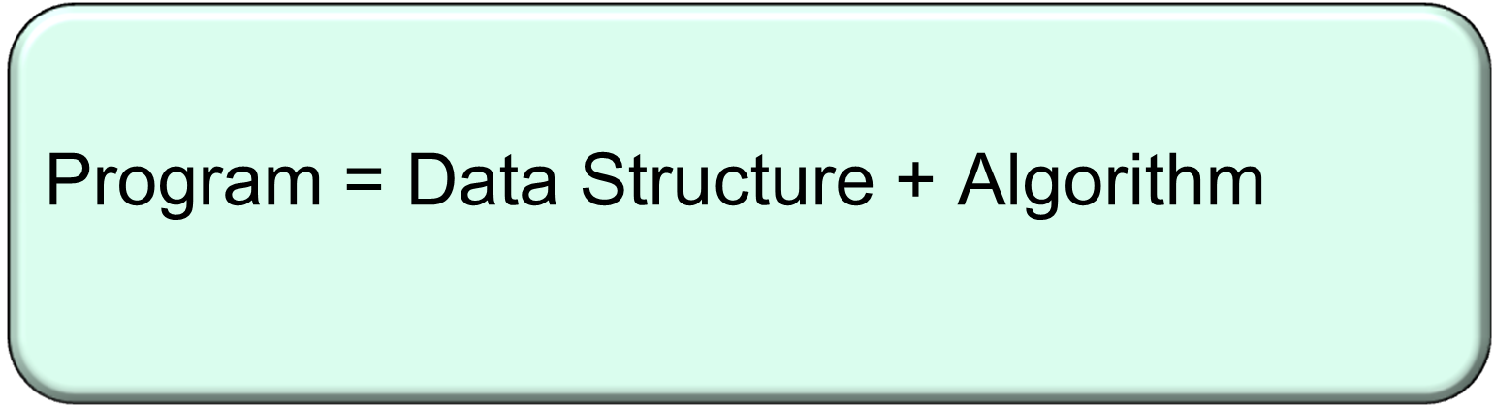
"Get your data structures correct first, and the rest of the program will write itself."
-Davids Johnson

Slide 8
“What is data? “
  DICT definition - The quantities, characters, or symbols on which a computer performs operations may be stored and transmitted in the form of electrical signals and recorded on magnetic, optical, or mechanical recording media.
  DATA and INFORMATION are often confusing, and we often interchange these two terms.
  UHDAM SI EMAN YM is just data because it is merely a collection of characters, and from this, the user cannot understand anything properly

Slide 9
What is information?”
If data is arranged systematically, then it gets a structure and becomes meaningful.
The need for Data Structures?
We can understand very well that the data needs to be managed in such a way so that it can produce some meaningful information.
Data structures give us the way to manage the data appropriately so that we can use it whenever possible.

Slide 10
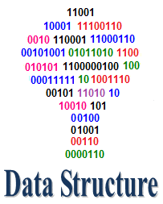
Data Structures
Data Structure is a way to store and organize data so that it can be used efficiently .
There are many ways of organizing the data in the memory, i.e., array.
Array is a collection of memory elements in which data is stored sequentially, i.e., one after another.
There are also other ways to organize the data in memory. Let's see the different types of data structures.

Slide 11
Deals with how
- organization of data in memory
- efficient Storage of data in memory
- efficient Retrieved & manipulated
- logical relationships among different data items

Slide 12
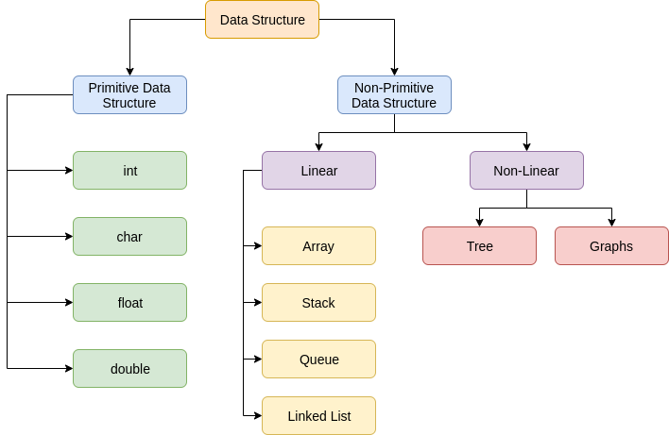
Classification (Primitive and Non Primitive)

Slide 13
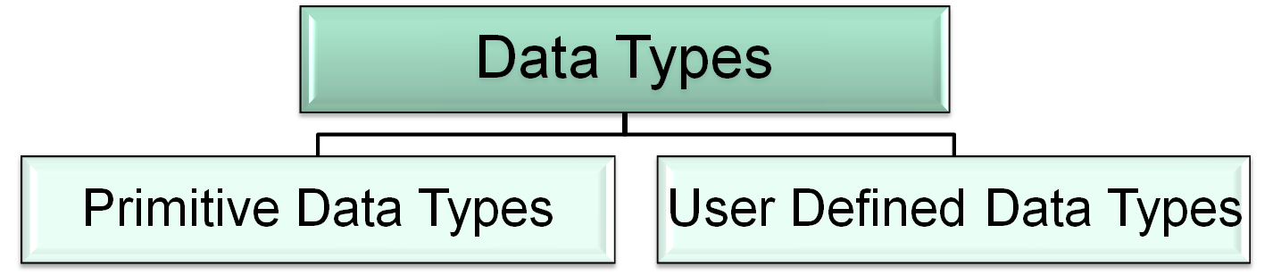
Data Types in C
Integer
Float
Double
Character
Void
Derived
Data Types
typedef
enum
Arrays
Functions
Pointers
Type Casting:
float div=float(a/b); //a & b are integer variables

Slide 14
Data type | Purpose | No. of bytes allocated | Range
int | To hold integer constant | 2 bytes | -32768 to +32767
float | To hold real constant | 4 bytes | -3.4e38 to +3.4e38
double | To hold real constant | 8 bytes | -1.7e308 to +1.7e308
char | To hold character constant | 1 byte | -128 to +127
void | non-specific | No memory is allocated | ------

Slide 15
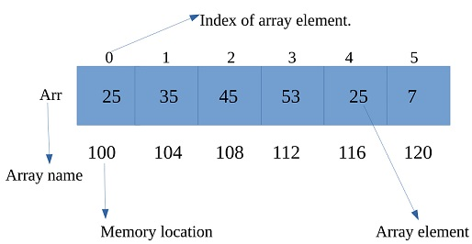
Array
Lower bound (lb)
Upper bound (ub)
An array is a data structure for storing more than one data item that has a similar data type.
The items of an array are allocated at adjacent memory locations.
Base address

Slide 16
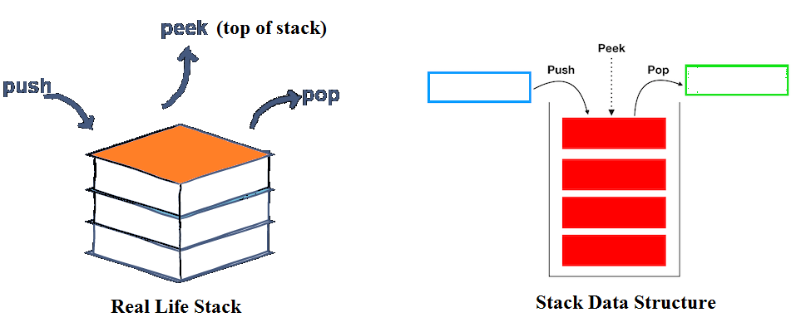
Stack
Stack is a linear data structure which follows a particular order in which the operations are performed. The order may be LIFO(Last In First Out) or FILO(First In Last Out)

Slide 17

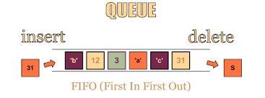
Queue
A Queue is a linear structure which follows a particular order in which the operations are performed. The order is First In First Out (FIFO). A good example of a queue is any queue of consumers for a resource where the consumer that came first is served first.

Slide 18
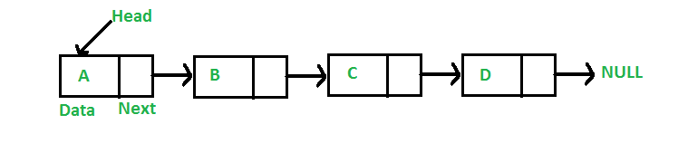
Linked List
A linked list is a linear data structure, in which the elements are not stored at contiguous memory locations. The elements in a linked list are linked using pointers as shown in the below image:
In simple words, a linked list consists of nodes where each node contains a data field and a reference(link) to the next node in the list.

Slide 19
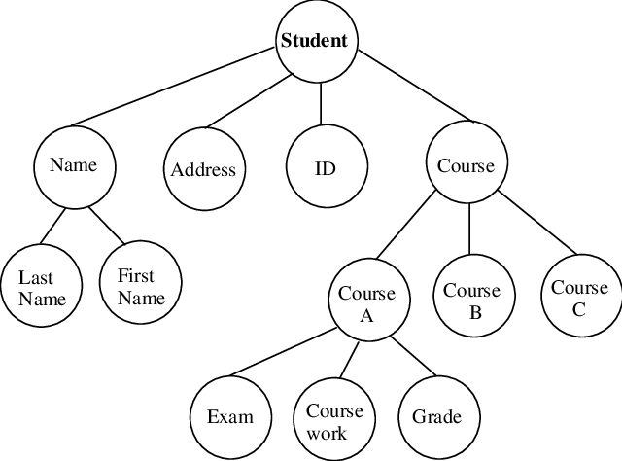
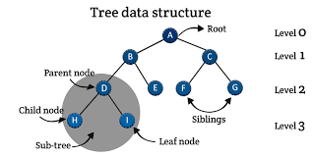
Tree
Data frequently contain a hierarchical relationship between various elements. The data structure which reflects this relationship is called a rooted tree graph or a tree.

Slide 20
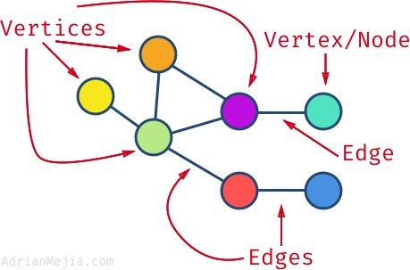
Graph
A Graph is a non-linear data structure consisting of nodes and edges. The nodes are sometimes also referred to as vertices and the edges are lines or arcs that connect any two nodes in the graph.
A Graph consists of a finite set of vertices(or nodes) and set of Edges which connect a pair of nodes.

Slide 21
Linear and Non- Linear Data Structure
In a linear data structure, the data items are arranged in a linear sequence. Example is array.
n a non-Linear data structure, the data items are not in a sequence. Example is tree.
homogeneous and Non- homogenous Data Structure In homogeneous Structure, all the elements are of same type. Example is arrays.
In Non-homogeneous structure, the elements may or may not be of same type.
Example is records.

Slide 22
Static and Dynamic Data Structure
Static structures are ones whose sizes and structures, associated memory
location are fixed at compile time.
Dynamic structures are ones which expand or shrink as required during the
program execution and there associated memory location change.

Slide 23
Data Structure Operations
Traversing: Traversing a Data Structure means to visit the element stored in it. This can be done with any type of DS.
Searching: Searching means to find a particular element in the given data-structure. It is considered as successful when the required element is found.
Insertion: It is the operation which we apply on all the data-structures. Insertion means to add an element in the given data structure.
Deletion: It is the operation which we apply on all the data-structures. Deletion means to delete an element in the given data structure.
Sorting: Sorting means arranging the data either in ascending or on decending.

Slide 24
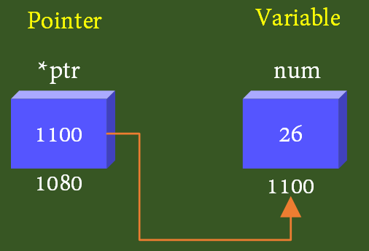
Pointers
->Pointer is a variable which can hold the address of another variable
->An alternative method to access the content of a memory location
1) Direct method
int num;
num=26;
printf("the content of the num is %d", num);
Printf("the address of the num is %x", &num); .

Slide 25
2. Indirect method (by using a pointer)
a. Creation of a pointer (declaration)
b. Assigning the created pointer the address
c. De-referencing the pointer access to the data
100 101
n
24
*p
int n;
int *p;
n=24;
p=&n;
printf("%d", *p);
p
100
Output: 24

Slide 26
100 101 102 103
Syntax for declaring a pointer
datatype * variable;
Ex: int *p;
float *q;
double *r;
float num;
float *q;
num=385.2367;
q=&num;
num
q
?
?
100 101 102 103
num
385.2367
q
100
Dangling pointers: Created pointers are not pointing to any particular variable

Slide 27
Pointer can be declared and initialized in the same line
int a;
a=10;
int a=10;
or
int *p;
p=&a;
int *p=&a;
In C language * is used for 3 purpose
1) To create a pointer
int *p;
2) To de reference a pointer
*p;
3) To multiply 2 variables
a * b;
In indirect method * is used for 2 purpose
1) To create a pointer
int *p;
2) To de reference a pointer
*p;

Slide 28
1.
int n=5;
int p;
p=&n;
printf("%d", *p);
2.
int n=5;
int *p;
p=n;
printf("%d", *p);
3.
int n=5;
int *p;
p=&n;
printf("%d", p);
4.
int n=5;
float *p;
p=&n;
printf("%d", *p);

Slide 29
Accessing variables through pointer
#include <stdio.h>
void main()
{
int a,b,c;
int *p, *q;
a=5;
b=10;
p=&a;
q=&b;
c=*p+*q;
printf("c is:%d",c);
}
1000
2000
3000
a
?
b
?
c
?
5000
6000
p
?
q
?
1000
2000
3000
a
5
b
10
c
?
p
1000
q
2000
Output:
c is: 15

Slide 30
Can there be more than one pointer to a variable?
#include <stdio.h>
void main()
{
int a;
int *p,*q,*r;
a=365;
p=&a;
q=&a;
r=&a;
printf("the value of a is:%d\n", a);
printf("the value of p is:%d\n",*p);
printf("the value of q is:%d\n",*q);
printf("the value of r is:%d\n",*r);
}
1000
a
?
5000
6000
7000
p
?
q
?
r
?
1000
a
365
5000
6000
7000
p
1000
q
1000
r
1000

Slide 31
Difference between pointer variable and normal variable
Pointer Variable | Normal Variable
1. Pointer Variable holds the address | 1. A normal variable holds data
2. int *p; | 2. int a;
3. We must de-reference a pointer to access data | 3. There is no need to de-refernce a normal variable to access data

Slide 32
Pointers and Arrays
0 1 2 3 4
int a[5]={10,20,30,40,50};
a
10 20 30 40 50
100 101 102 103 104
*p
int *p;
p=&a[0]; or p=a;
p
0 1 2 3 4
for(int i=0; i<4; i++)
{
printf("%d\t", *p);
p++;
}
a
10 20 30 40 50
100 101 102 103 104
*p
p

Slide 33
0 1 2 3 4
a
1.1 1.2 1.3
100 101 102 103 104
*p
p
sum = sum + *(p+i)
Sum=0.0+1.1=1.1
Sum=1.1+1.2=2.3
sum=2.3+1.3=3.6

Slide 34
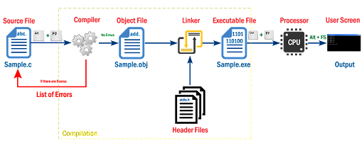
Dynamic memory allocation
Conversion from HLL to MLL
Decision to allocate memory to variable
Execution of machine level instructions
Decision to allocate memory to variable
Compilation
Execution
Static Memory Allocation
Dynamic Memory Allocation

Slide 35
Static Memory Allocation
Wastage of memory
Reediting is a time consuming process
Dynamic Memory Allocation
malloc()
calloc()
realloc()
free()

Slide 36
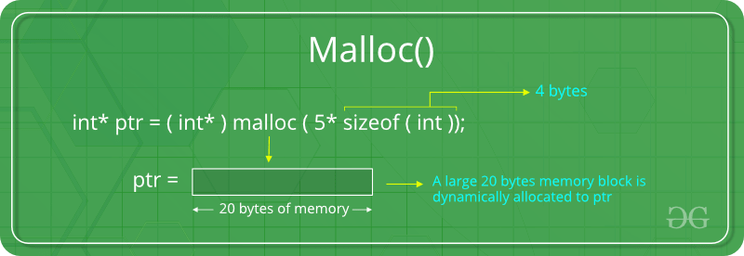
malloc()
malloc stands for Memory allocation
General form of memory allocation using malloc is,
datatype *ptr = (datatype *) malloc(RequiredAmountOfMemory * sizeof(datatype));
If malloc() is unable to find the required amount of memory, it returns NULL

Slide 37
Example
p = (int *) malloc(100 * sizeof(int));
A memory space equivalent to 100 times the size of an int bytes is reserved
The address of the first byte of the allocated memory is assigned to the pointer p of type int
On successful allocation, the function returns the address of first byte of allocated memory.
Since address is returned, the return type is a void pointer. By type casting appropriately we can use it to store integer, float etc.

Slide 38
cptr = (char *) malloc (20);
Allocates 20 bytes of space for the pointer cptr of type char
sptr = (struct stud *) malloc(10*sizeof(struct stud));
Allocates space for a structure array of 10 elements. sptr
points to a structure element of type struct stud
Always use sizeof operator to find number of bytes for a data type, as it can vary from machine to machine

Slide 39
void main()
{
int n,i;
printf("enter the number of elements\n");
scanf("%d",&n);
int *p = (int *)malloc(n*sizeof(int));
if(p == NULL)
{
printf("enough memory not available");
exit(0);
}
printf("enter array elements\n");
for(i=0; i<n; i++)
{
scanf("%d", p+i);
}
printf("array elements are\n");
for(i=0; i<n; i++)
{
printf("%d\t", *(p+i));
}
}

Slide 40
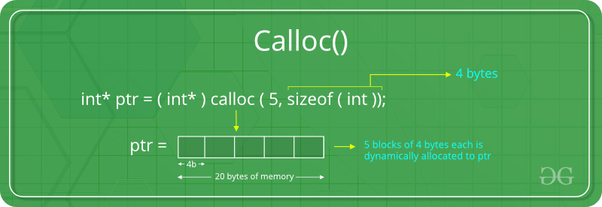
calloc()
calloc stands for Contiguous allocation of multiple blocks.
General form of memory allocation using calloc is,
datatype *ptr = (datatype *) calloc(n, sizeof(datatype));
If calloc() is unable to find the required amount of memory, it returns NULL

Slide 41
void main()
{
int n,i;
printf("enter the number of elements\n");
scanf("%d",&n);
int *p = (int *)calloc(n,sizeof(int));
if(p == NULL)
{
printf("enough memory not available");
exit(0);
}
printf("enter array elements\n");
for(i=0; i<n; i++)
{
scanf("%d", p+i);
}
printf("array elements are\n");
for(i=0; i<n; i++)
{
printf("%d\t", *(p+i));
}
}

Slide 42
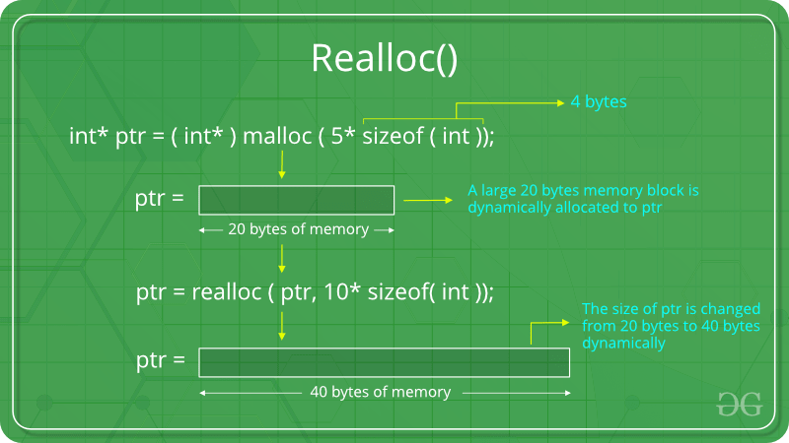
realloc()
realloc stands for re allocation
General form of memory allocation using realloc is,
ptr = (datatype *) realloc(p, newsize*sizeof(datatype));

Slide 43
realloc() changes the size of the block by extending or deleting the memory at the end of the block.
If the existing memory can be extended, ptr value will not be changed
If the memory cannot be extended, this function allocates a completely new block and copies the contents of existing memory block into new memory block and then deletes the old memory block.

Slide 44
void main()
{
int n,i,new;
printf("enter the number of elements\n");
scanf("%d",&n);
int *p = (int *)malloc(n*sizeof(int));
if(p == NULL)
{
printf("enough memory not available");
exit(0);
}
printf("enter array elements\n");
for(i=0; i<n; i++)
{
scanf("%d", p+i);
}
printf("array elements are\n");
for(i=0; i<n; i++)
{
printf("%d\t", *(p+i));
}
printf("\nenter the new number of elements\n");
scanf("%d",&new);
p=(int *)realloc(p,new*sizeof(int));
printf("enter array elements\n");
for(i=0; i<new; i++)
{
scanf("%d", p+i);
}
printf("array elements are\n");
for(i=0; i<new; i++)
{
printf("%d\t", *(p+i)); }}

Slide 45
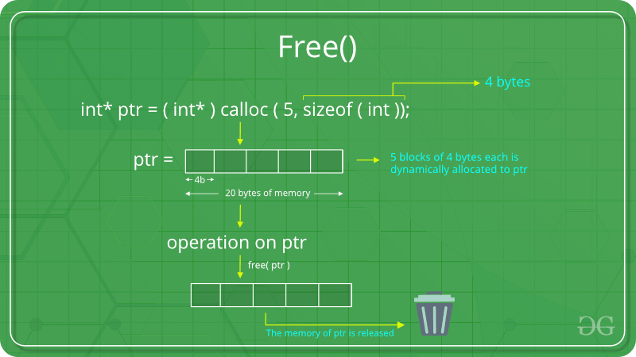
free()
Dynamically allocated memory form calloc() or malloc() should be freed(released) using free().
General format:
void free(void *ptr);
Or
free(ptr);

Slide 46
void main()
{
int n,i;
printf("enter the number of elements\n");
scanf("%d",&n);
int *p = (int *)malloc(n*sizeof(int));
if(p == NULL)
{
printf("enough memory not available");
exit(0);
}
printf("enter array elements\n");
for(i=0; i<n; i++)
{
scanf("%d", p+i);
}
printf("array elements are\n");
for(i=0; i<n; i++)
{
printf("%d\t", *(p+i));
}
free(p);
}

Slide 47




Arrays
Tree
Array of trees
Student
Array of students

Slide 48
Array is a container which can hold a fix number of items and these items should be of the same type. Most of the data structures make use of arrays to implement their algorithms. Following are the important terms to understand the concept of Array.
Element − Each item stored in an array is called an element.
Index − Each location of an element in an array has a numerical index, which is used to identify the element.
Array Representation - Arrays can be declared in various ways in different languages.

Slide 49
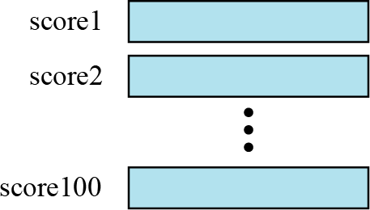
Imagine that we have 100 scores. We need to read them, process them and print them. We must also keep these 100 scores in memory for the duration of the program. We can define a hundred variables, each with a different name.

Slide 50
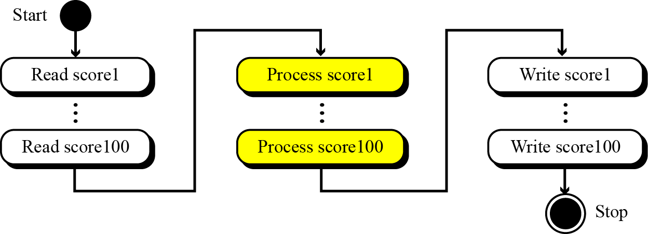
But having 100 different names creates other problems. We need 100 references to read them, 100 references to process them and 100 references to write them.

Slide 51
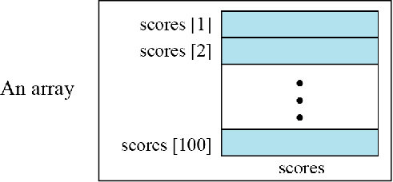
An array is a sequenced collection of elements, normally of the same data type, although some programming languages accept arrays in which elements are of different types. We can refer to the elements in the array as the first element, the second element and so forth, until we get to the last element.

Slide 52
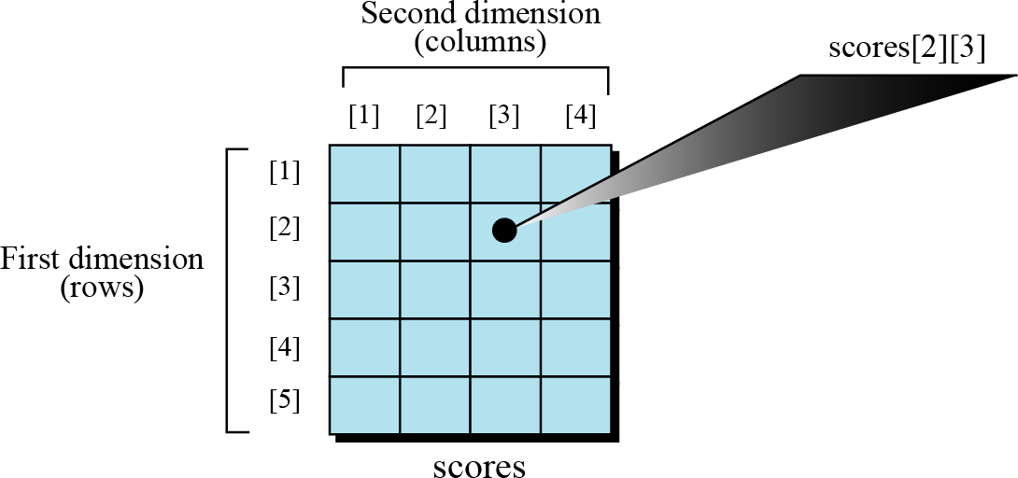
Multi-dimensional arrays
The arrays discussed so far are known as one-dimensional arrays because the data is organized linearly in only one direction. Many applications require that data be stored in more than one dimension. Figure shows a table, which is commonly called a two-dimensional array

Slide 53
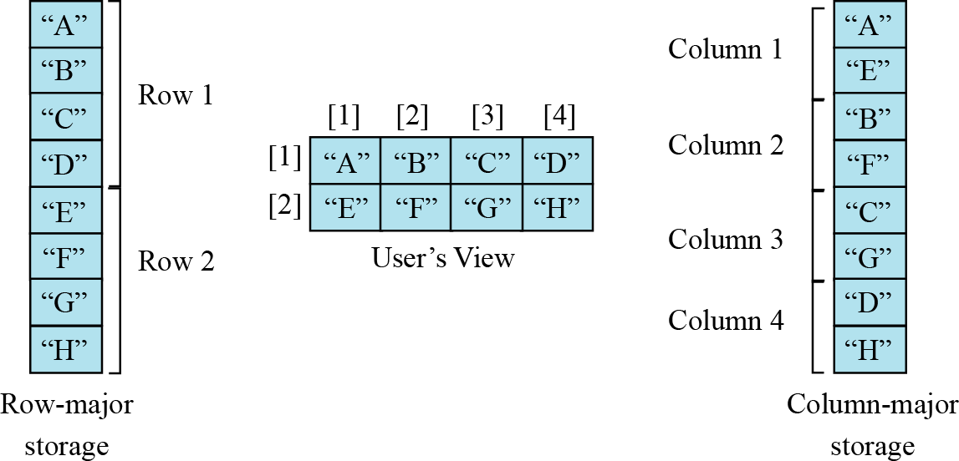
Memory Layout
The indexes in a one-dimensional array directly define the relative positions of the element in actual memory. Figure shows a two-dimensional array and how it is stored in memory using row-major or column-major storage. Row- major storage is more common.

Slide 54
Dynamically allocated Arrays
#include <stdio.h>
#include <stdlib.h>
void main()
{
int r = 3, c = 4, i; //Taking number of Rows and Columns
int *ptr; //creating pointer
ptr = (int *)malloc((r * c) * sizeof(int)); //Dynamically Allocating Memory (12*2=24)
for(i = 0; i < r * c; i++)
{
ptr[i] = i + 1; //Giving value to the pointer and simultaneously printing it.
printf("%d ", ptr[i]);
if ((i + 1) % c == 0)
{
printf("\n");
}
}
free(ptr);
}

Slide 55
35
23
45
20
100
70
35.5
11.5
34.3
15.9
90.6
46.7
m
a
t
u
w
r
Array means, a series of entities or a sequence of entities of the same type (homogeneous). In C language entities can be char, int, float and double type data

Slide 56

Declaration of 1-D array
Syntax:
datatype arrayname[size];
Ex: int a[5];
float b[5];
A declaration statement tells the compiler,
->data type of the array
->name of the array
->size of the array
Compiler then allocate memory depending upon the declaration.
a
a[0]
a[1]
a[2]
a[3]
a[4]
b
b[0]
b[4]
b[0]
b[1]
b[2]
b[3]
b[1]
b[2]
b[3]

Slide 57
Initialization of 1-D array
1) Direct Initialization (Compile time initialization)
2) Initialization using a for loop (Run time initialization)
1) Direct Initialization : Mentioning array size is not compulsory.
Ex: int a[5] = {29, 47, 132, 229, 50 };
29
47
132
229
50
29
47
132
a[0]
a[1]
a[2]
a[3]
a[4]
Ex: float b[5] = {29.3, 47.1, 132.4, 229.6, 50.3 };
29.3
47.1
132.4
229.6
50.3
b[0]
b[1]
b[2]
b[3]
b[4]

Slide 58
2) Initialization using a for loop:
->Using a for loop to initialize the array blocks
->Mentioning array size is compulsory
int a[5];
int i;
printf(" Enter an integer");
for(i=0; i<=4; i++)
{
scanf("%d", &a[i]);
}
a[0]
a[1]
a[2]
a[3]
a[4]
29
47
132
229
50
29
47
132
229
50
a[0]
a[1]
a[2]
a[3]
a[4]

Slide 59
How do we store single integer in memory and how do we store array of integers in memory?
To store single integer,
int a = 35;
To store array of integers,
int a[5] = {35,39,87,53,28};
a
35 | 39 | 87 | 53 | 28
a
35
a[0]
a[1]
a[2]
a[3]
a[4]
Note: Array is a Indexed Data Structure
Total size of the array=size of the array * number of bytes per block
=5*2
=10 bytes

Slide 60
#define N 20
#define M 10
int main()
{
char word[N], *w[M];
int i, n;
scanf("%d",&n);
for (i=0; i<n; ++i) { scanf("%s", word);
w[i] = (char *) malloc ((strlen(word)+1)*sizeof(char));
strcpy (w[i], word) ;
}
for (i=0; i<n; i++) {
printf("w[%d] = %s \n",i,w[i]);
return 0;
}
4
Tendulkar Sourav Khan
Khan
India
w[0] = Tendulkar w[1] = Sourav
w[2] = Khan

Slide 61
w
0
1
2
3
T | e | n | d | u | l | k | a | r | \0
S | o | u | r | a | v | \0
K | h | a | n | \0
I | n | d | i | a | \0

Slide 62
1. A car manufacturing company uses an array car to record number of cars sold each year starting from 1965 to 2015
i) Find the total number of years(elements)
ii) Suppose base address = 500, word length (w) = 4, find address of car[1967], car[1969] and car[2015]

Slide 63

Two Dimensional Array
Student
1-D array of Students
2-D array of Student

Slide 64
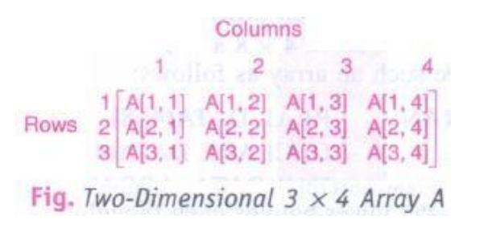
Multidimensional Arrays
Two-dimensional arrays are called matrices in mathematics and tables in business applications. There is a standard way of drawing a two-dimensional m x n array A where the elements of a form a rectangular array with m rows and n columns and where the element A[J, K] appears in row J and column K.

Slide 65
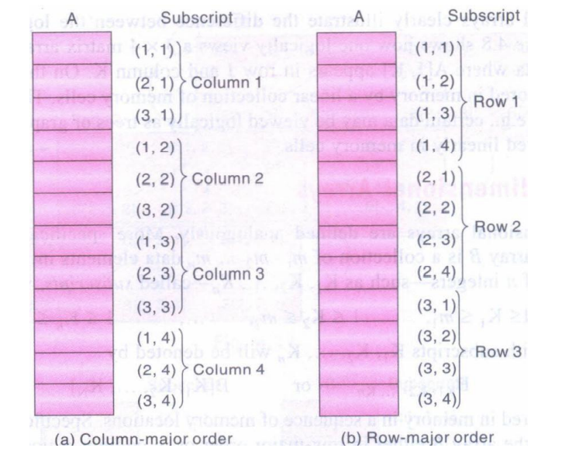
Representation of Two-Dimensional Arrays in Memory
Let A be a two-dimensional m x n array. Although A is pictured as a rectangular array of
elements with m rows and n columns, the array will be represented in memory by a block of m . n sequential memory locations.
The programming language will store the array A either (1) column by column, is called
column-major order, or (2) row by row, in row-major order.
(Column-major order) LOC(A[J, K]) = Base(A) + w[M(K - 1)+ (J - 1)]
(Row-major order) LOC(A[J, K]) = Base(A) + w[N(J - 1) + (K - 1)]

Slide 66
A two dimensional array is represented as one-dimensional array of pointers where each pointer contains address of one-dimensional array.
For example, consider the following declaration: int a[3][5];
Recall that address of [i][j]-th element is found by first finding the address of first element of i-th row, then adding j to it.

Slide 67
Now think of a 2-d array of dimension [M][N] as M 1-d arrays, each with N elements, such that the starting address of the M arrays are contiguous (so the starting address of k-th row can be found by adding 1 to the starting address of (k-1)-th row)
This is done by allocating an array p of M pointers, the pointer p[k] to store the starting address of the k-th row

Slide 68
Structures
struct student
{
  char name[5];
  int age;
  int marks;
  char USN;
};
Student:
Name
Age
Marks
USN
int a;
struct tree
{
  char name[5];
  int No.of branches;
  float height;
};
Tree:
Name
No. of branches
height
float b;

Slide 69
Structures
Structure provides a mechanism for the programmer to create his/her own data type called "user defined date type"
struct student
{
  char name[20];
  int age;
  int marks;
  float height;
};
Keyword for creating structure
Name of the structure
Structure members/data

Slide 70
Syntax
Ex. 1
Ex. 2
struct structure_name
{
  datatype member variable 1;
  datatype member variable 2;
  datatype member variable 3;
  datatype member variable 4;
};
struct student
{
  char name[20];
  int age;
  int marks;
  float height;
};
struct tree
{
  char name[5];
  int No.of branches;
  float height;
};

Slide 71
Structures
struct student
{
  char name[5];
  int age;
  int marks;
  float height;
};
struct tree
{
  char name[5];
  int No.of branches;
  float height;
};
To access members of a structure, a structure variable has to be created
struct student s1;
struct tree t1;

Slide 72
struct student
{
  char name[5];
  int age;
  int marks;
  float height;
};
struct student s1;
0
1
2
3
4
5
6
7
8
9
10
11
12
s1
Memory to store name
Memory to store age
Memory to store marks
Memory to store height
Fig: Memory for structure member

Slide 73
struct student
{
  char name[5];
  int age;
  int marks;
  float height;
};
struct student s1;
0
1
2
3
4
5
6
7
8
9
10
11
12
R
a
m
u
/0
s1
23
80
s1.name="Ramu";
s1.age=23;
s1.marks=80;
s1.height=5.5;
.(dot) -> Member access operator
5.5

Slide 74
t1
struct tree
{
  char name[5];
  int noofbranches;
  float height;
};
struct tree t1;
t
e
a
k
/0
0
1
2
3
4
5
6
7
8
9
10
11
12
13
14
15
23
t1.name="teak";
t1.noofbranches=23;
t1.height=31.71;
.(dot) -> Member access operator
31.71

Slide 75
printf("Enter Student Details\n");
printf("enter the name of the student\n");
scanf("%s", s1.name);
printf("enter student age\n");
scanf("%d", &s1.age);
printf("enter student marks\n");
scanf("%d", &s1.marks);
printf("enter student height\n");
scanf("%f", &s1.height);
printf("Student details you entered:\n");
printf("Student name is: %s\n",s1.name);
printf("Student age is: %d\n",s1.age);
printf("Student marks is: %d\n", s1.marks);
printf("student height is: %.2f\n",s1.height);
}
//program to read and display student details using structures
#include <stdio.h>
struct student
{
char name[20];
int age;
int marks;
float height;
};
void main()
{
struct student s1;

Slide 76
//program to read and display tree details using structures
#include <stdio.h>
struct tree
{
char name[20];
float height;
int noofbranches;
};
void main()
{
struct tree t1;
printf("enter the name of the tree\n");
scanf("%s", t1.name);
printf("enter tree height\n");
scanf("%f", &t1.height);
printf("enter number of noofbranches\n");
scanf("%d", &t1.noofbranches);
printf("the tree name is: %s\n",t1.name);
printf("the tree height is: %f\n",t1.height);
printf("noofbranches in the tree are: %d\n",t1.noofbranches);
}

Slide 77
Array | Structure
Array is a collection of related data elements of same data type. (homogeneous data) | Structure is collection of logically related data elements of different data types. (heterogeneous data)
Array data are accessed using index | Structure data are accessed using structure name and dot operator
No key word is used to create array | Struct keyword is used create structure
Each element will be of same size | Size of the elements can be different

Slide 78
Structures and Functions
#include <stdio.h>
struct tree
{
char name[20];
float height;
int noofbranches;
};
void disp(struct tree tr)
{
printf("the tree name is: %s\n",tr.name);
printf("the tree height is: %f\n",tr.height);
printf("noofbranches in the tree are: %d\n",tr.noofbranches);
}
void main()
{
struct tree t1;
printf("enter the name of the tree\n");
scanf("%s", t1.name);
printf("enter tree height\n");
scanf("%f", &t1.height);
printf("enter number of noofbranches\n");
scanf("%d", &t1.noofbranches);
disp(t1);
}

Slide 79
Array of Structures
0 1 2 3 4 5 6 7 8
s
1000
2000
3000
1000
2000
3000
Aftab
Amulya
Name
hhs235
dsd23
USN
80
90
70

Slide 80
Array of Structures
printf("enter the name of the tree\n");
scanf("%s", t1[i].name);
printf("enter tree height\n");
scanf("%f", &t1[i].height);
printf("enter number of noofbranches\n");
scanf("%d", &t1[i].noofbranches);
}
for(int i=0; i<=1; i++)
{
printf("the tree name is: %s\n",t1[i].name);
printf("the tree height is: %f\n",t1[i].height);
printf("noofbranches in the tree are: %d\n",t1[i].noofbranches);
}
}
#include <stdio.h>
struct tree
{
char name[20];
float height;
int noofbranches;
};
void main()
{
struct tree t1[2];
for(int i=0; i<=1; i++)
{

Slide 81
#include<stdio.h>
typedef struct
{
char name[10];
int usn;
}student;
void main()
{
student s1;
printf("enter student name:\n");
scanf("%s", s1.name);
printf("enter student usn:\n");
scanf("%d", &s1.usn);
printf("student name is %s",s1.name);
printf("student usn is %d", s1.usn);
}
Typedefing a Structures
The typedef is a keyword that is used to provide existing data types with a new name.
The C typedef keyword is used to redefine the name of already existing data types.

Slide 82
Different ways of writing a program using structure
#include<stdio.h>
struct student
{
char name[10];
int usn;
};
void main()
{
struct student s1;
printf("enter student name:\n");
scanf("%s", s1.name);
printf("enter student usn:\n");
scanf("%d", &s1.usn);
printf("student name is %s\n",s1.name);
printf("student usn is %d", s1.usn);
}
#include<stdio.h>
struct student
{
char name[10];
int usn;
}s1;
void main()
{
printf("enter student name:\n");
scanf("%s", s1.name);
printf("enter student usn:\n");
scanf("%d", &s1.usn);
printf("student name is %s\n",s1.name);
printf("student usn is %d", s1.usn);
}
#include<stdio.h>
typedef struct
{
char name[10];
int usn;
}student;
void main()
{
student s1;
printf("enter student name:\n");
scanf("%s", s1.name);
printf("enter student usn:\n");
scanf("%d", &s1.usn);
printf("student name is %s\n",s1.name);
printf("student usn is %d", s1.usn);
}

Slide 83
#include<stdio.h>
struct address
{
char city[20];
int pin;
char phone[14];
};
struct employee
{
char name[20];
struct address add;
};
void main ()
{
struct employee emp;
printf("Enter employee information?\n");
scanf("%s %s %d %s",emp.name,emp.add.city, &emp.add.pin, emp.add.phone);
printf("Printing the employee information....\n");
printf("name:%s\nCity:%s\nPincode:%d\nPhone:%s",emp.name,emp.add.city,emp.add.pin,emp.add.phone);
}

Slide 84
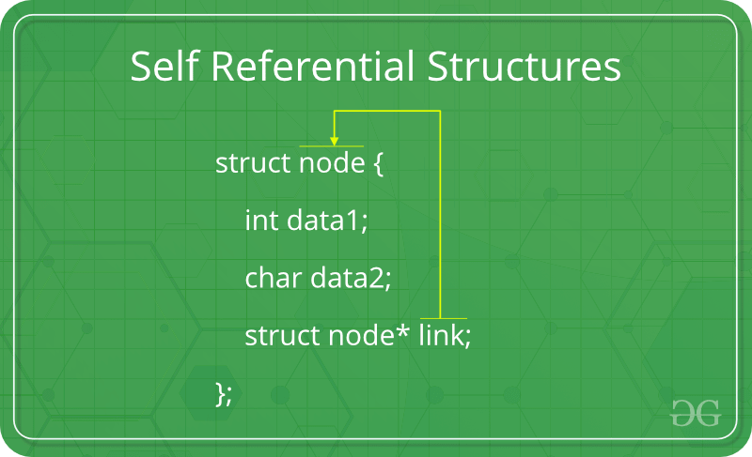
Self-Referential Structures
A self-referential structure is one in which one or more of its components is a pointer to itself. Self referential structures usually require dynamic storage management routines (malloc and free) to explicitly obtain and release memory.
typedef struct {
char data;
struct list *link ;
} list;
Each instance of the structure list will have two components data and link.
• Data: is a single character,
• Link: link is a pointer to a list structure. The value of link is either the address in memory of an instance of list or the null pointer.

Slide 85
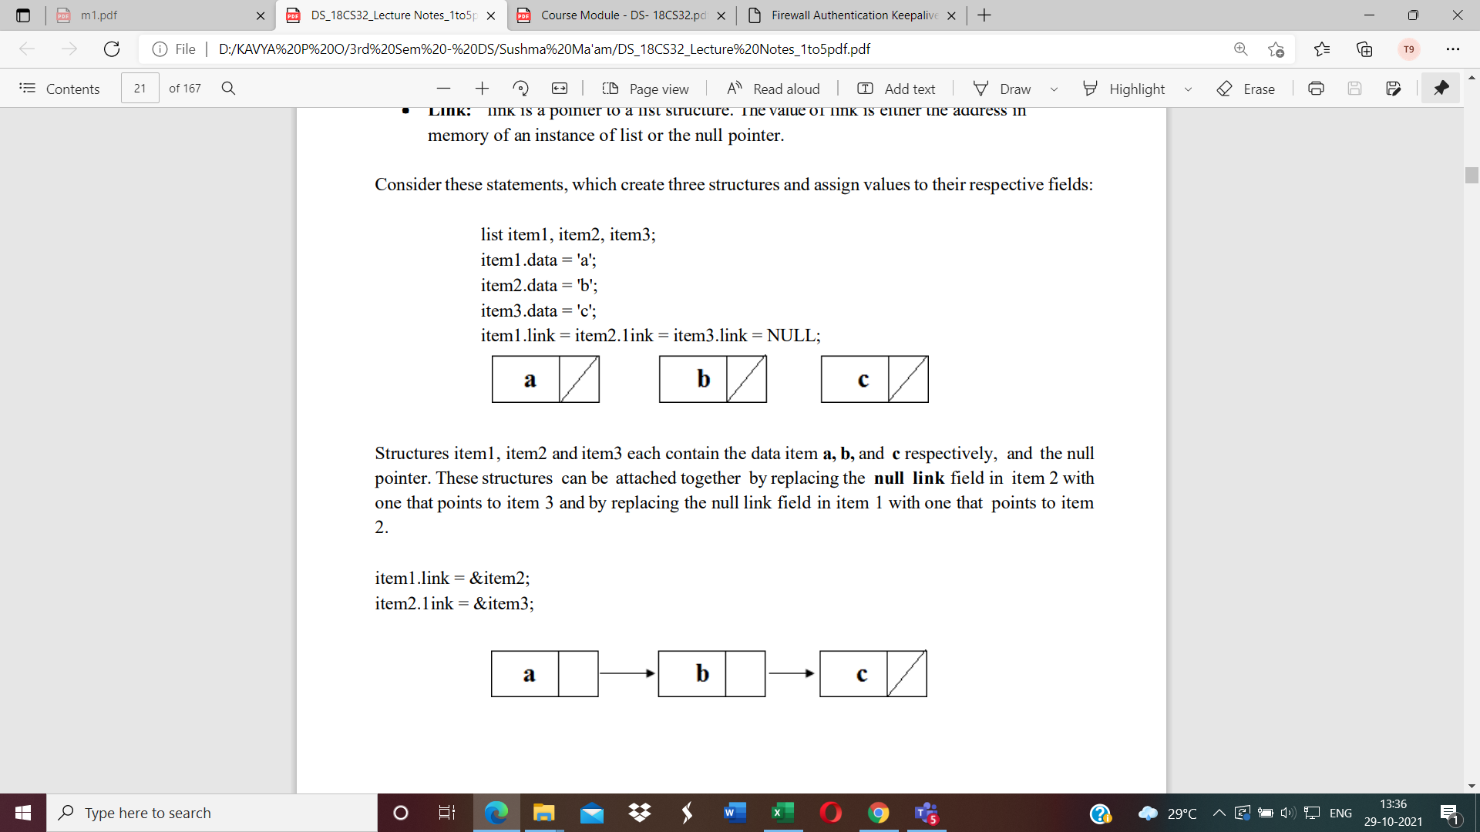
Self-Referential Structures

Slide 86
Union
A union is similar to a structure, it is collection of data similar data type or dissimilar.
Syntax:
union tag_name{
data_type member 1;
data_type member 2;
………………………
………………………
data_type member n;
}variable_name;

Slide 87
Union
typedef union
{
int i;
double d;
char c;
}item;
union item
{
int i;
double d;
char c;
};
item x;
x
c
i
d

Slide 88
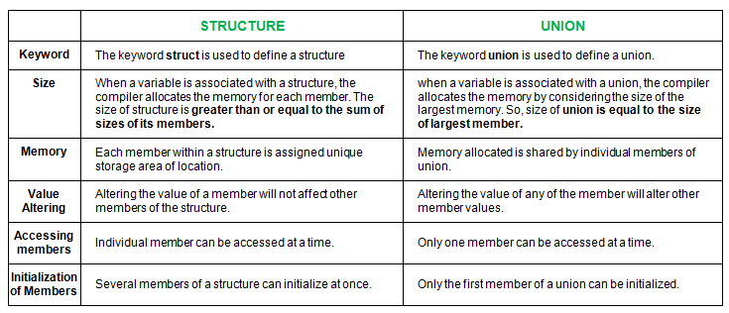
Difference between Structure and Union

Slide 89


void main()
{
typedef union
{
int marks;
char grade;
float percentage;
}student;
student s;
S.marks=90;
printf("marks:%d\n",s.marks);
s.grade='A';
printf("Grade:%c\n",s.grade);
s.percentage=90.0;
printf("percentage:%f\n",s.percentage);
}
void main()
{
typedef struct
{
int marks;
char grade;
float percentage;
}student;
student s;
s.marks=90;
s.grade='A';
s.percentage=90.0;
printf("marks:%d\n",s.marks);
printf("Grade:%c\n",s.grade);
printf("percentage:%f\n",s.percentage);
}
marks: 90
grade: A
percentage: 90.0

Slide 90
Polynomials
A polynomial is a sum of terms, where each term has a form ax^{e} , where x is the variable, a is the coefficient and e is the exponent
A(x) = 3x²⁰ + 2x⁵ + 4
B(x) = x⁴ + 10x³ + 3x²+1
The largest (or leading) exponent of a polynomial is called its degree. Coefficients that are zero are not displayed. The term with exponent equal to zero does not show the variable since x raised to a power of zero is 1.

Slide 91
Polynomial Representation
One way to represent polynomials in C is to use typedef to create the type polynomial as below:
#define MAX_TERMS 100 /*size of terms array*/
typedef struct
{
float coef;
int expon;
} polynomial;
polynomial terms[MAX-TERMS];
int avail = 0;
3x²⁰ + 2x⁵ + 4
3
20
2
5
4
0
cf ex
cf ex
cf ex
term[0]
term[1]
term[2]

Slide 92
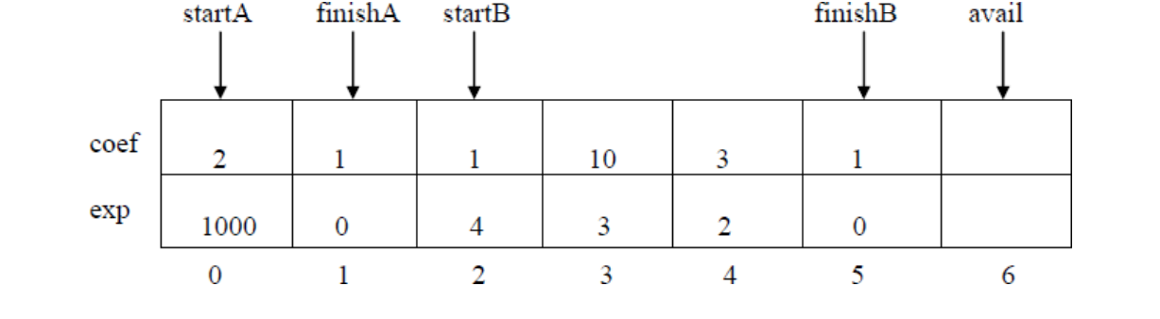
Consider the two polynomials
A(x) = 2x^{l000}+ 1
B(x) = x⁴ + 10x³ + 3x² +1
The above figure shows how these polynomials are stored in the array terms. The index of the first term of A and B is given by startA and startB, while finishA and finishB give the index of the last term of A and B.
• The index of the next free location in the array is given by avail.
• For above example, startA=0, finishA=1, startB=2, finishB=5, & avail=6.

Slide 93
int i;
for(i=0; i<n; i++)
{
if(p[i].cf < 0)
printf("%d",p[i].cf);
if(p[i].px != 0)
printf("x^%d",p[i].px); }
printf("\n");}
void main()
{
int n;
poly p[10];
printf("enter number of terms:\n");
scanf("%d", &n);
read_poly(p, n);
print_poly(p,n);
}
Program to read and display Polynomial
#include<stdio.h>
typedef struct
{
int cf; //used to hold coefficient
int px; //used to hold power of x
}poly;
//function to read a polynomial with n terms
void read_poly(poly p[], int n)
{
int i,cf,px;
for(i=0; i<n; i++)
{
printf("enter Coefficient and exponent:");
scanf("%d%d", &p[i].cf, &p[i].px););
}
}
//function to display a polynomial with n terms
void print_poly(poly p[], int n)
{

Slide 94
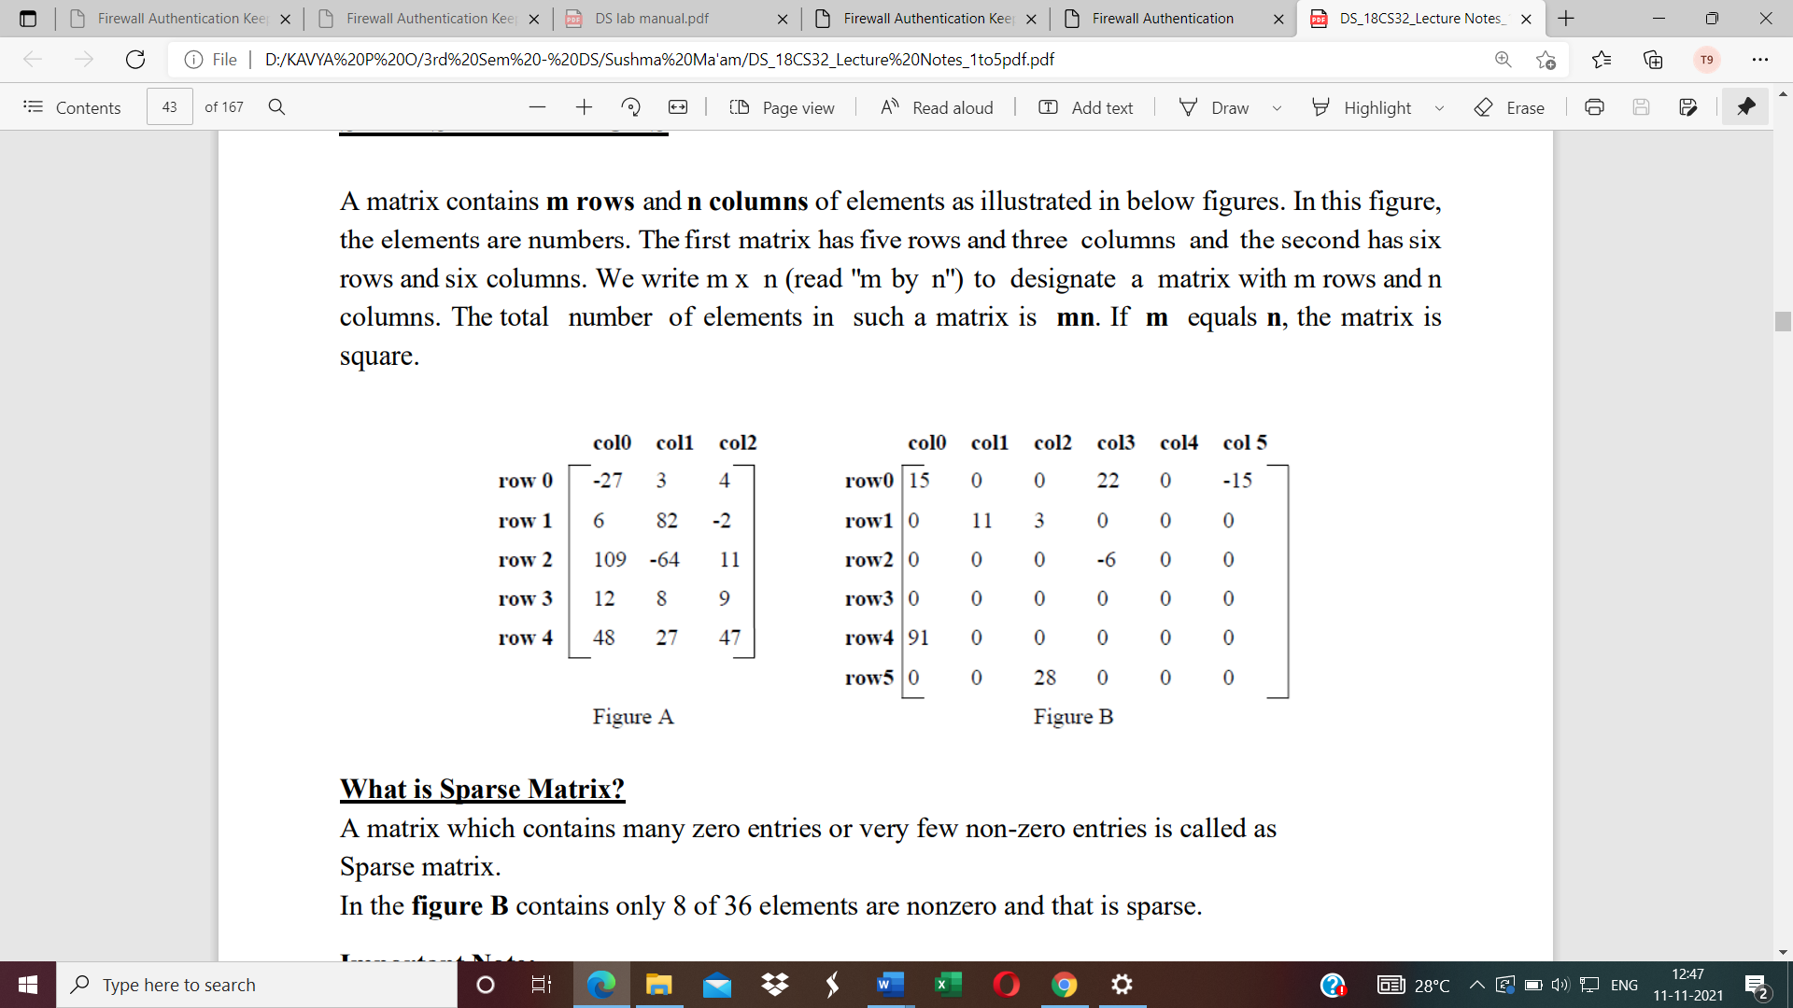
SPARSE MATRICES
What is Sparse Matrix?
A matrix which contains many zero entries or very few non-zero entries is called as Sparse matrix.
In the figure B contains only 8 of 36 elements are nonzero and that is sparse.
A sparse matrix can be represented in 1-Dimension, 2- Dimension and 3- Dimensional array.
When a sparse matrix is represented as a two-dimensional array as shown in Figure B, more space is wasted.

Slide 95
Sparse Matrix Representation
• An element within a matrix can characterize by using the triple <row, col, val> This means that, an array of triples is used to represent a sparse matrix.
• Organize the triples so that the row indices are in ascending order.
• The operations should terminate, so we must know the number of rows and columns,
and the number of nonzero elements in the matrix.
#define MAX_TERMS 100 /* maximum number of terms */
typedef struct
{
int col;
int row;
int value;
} TERM;
//1- dimensional array representing array of triples<row,col,val>
TERM a[MAX_TERMS];

Slide 96
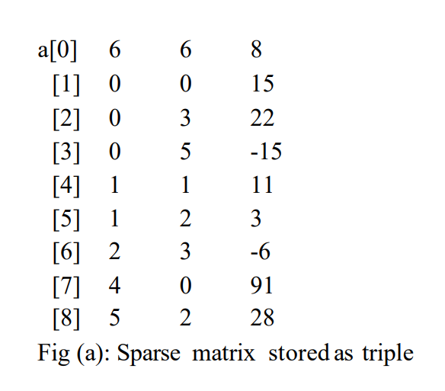
The below figure shows the representation of matrix in the array “a” a[0].row contains the number of rows, a[0].col contains the number of columns and a[0].value contains the total number of nonzero entries.
Row
Col
Val
6X6 is the size and 8 non zero values in given matrix
Row 0
Row 1
Row 2
Row 4
Row 5

Slide 97
The various information can be accessed using as shown below:
◻ The size of the matrix using : a[0].row, a[0].col
◻ The number of non-zero elements using : a[0].val
◻ The row index of a non-zero element : a[j].row
◻ The column index of a non-zero element : a[j].col for j = 1 to a[0].col
◻ The index of non-zero element : a[j].val

Slide 98
//Function to read the sparse matrix as a triple
void read_sparse_matrix(TERM a[], int m, int n)
{
int i,j,k,item;
a[0].row=m, a[0].col=n, k=1;
for(i=0; i<m; i++)
{
for(j=0; j<n; j++)
{
scanf("%d",&item);
if(item==0)
continue;
a[k].row=i, a[k].col=j, a[k].val=item;
k++;
}
}
a[0].val=k-1;
}
Row
Col
Val
6X6 is the size and 8 non zero values in given matrix
Row 0
Row 1
Row 2
Row 4
Row 5

Slide 99
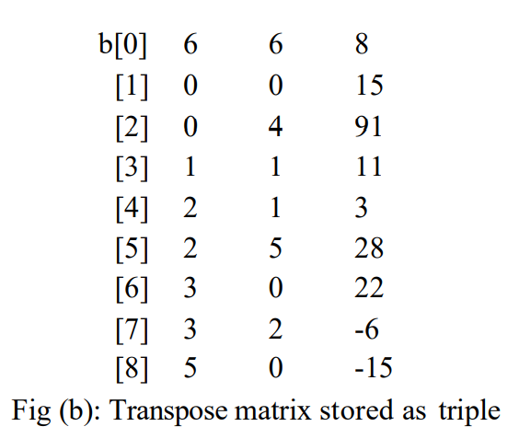
Row
Col
Val
Transpose of a matrix
Row
Col
Val
6X6 is the size and 8 non zero values in given matrix
Col 0
Col 1
Col 2
Col 3
Col 5

Slide 100
Row
Col
Val
//Function to find the transpose of a given sparse matrix matrix
void transpose(TERM a[], TERM b[])
{
int i,j,k;
b[0].row=a[0].col;
b[0].col=a[0].row;
b[0].val=a[0].val;
k=1;
for(i=0; i<a[0].col; i++)
{
for(j=1; j<a[0].val; j++)
{
if(a[j].col==i)
{
b[k].row=a[j].col;
b[k].col=a[j].row;
b[k].val=a[j].val;
k++;
}
}
}
}
Row
Col
Val

