Slide 1
Digital Electronic Circuits – 1BEE304
Prepared By,
Ms. Swathi C A
Asst Professor
Dept of EEE
ATMECE, Mysuru

Slide 2
What is Digital Electronics?
Branch of electronics dealing with discrete signals (0s & 1s)
Opposite of Analog Electronics (continuous signals)
Foundation of computers, mobiles, control systems

Slide 3
Analog vs Digital Signals
Analog: Continuous, smooth variation (e.g., sound, temperature)
Digital: Discrete steps (0 or 1, ON or OFF)
Example: Sine wave vs Square wave

Slide 4
Binary Logic
Two logic levels: 0 (Low = 0V), 1 (High = +5V or +3.3V)
Computers use binary as circuits detect two states (ON/OFF)

Slide 5
Applications of Digital Electronics
Computers and laptops
Mobile phones
Digital watches
Industrial automation
Smart home devices

Slide 6
Fundamentals: Logic Gates
Logic gates are the basic building blocks of any digital system.
Implements Boolean functions that performs a logic operation on one or more bits of input and gives a bit as an output
The relationship between the input and the output is based on a certain logic.

Slide 7
Logic Gates
AND Gate → Output is 1 if all inputs are 1
OR Gate → Output is 1 if any input is 1
NOT Gate → Inverts input
NAND & NOR are universal gates
Truth tables and symbols are key

Slide 8
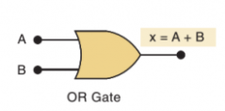
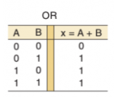
Logic Gates [Contd. . ]
The basic logic gates are classified into seven types:
AND gate, OR gate, NOT, XOR gate, NAND gate, NOR gate, XNOR gate.
The truth table is used to show the logic gate function
OR Gate: Expression: x = A + B
Symbol: Truth Table of OR Gate

Slide 9

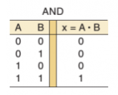
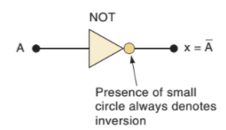

Logic Gates [Contd. . ]
2. AND Gate: Expression: x = A . B
Symbol: Truth Table of AND Gate
3. NOT Gate: Expression: A = A’
Symbol: Truth Table of NOT Gate

Slide 10


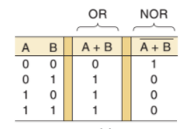

Logic Gates [Contd. . ]
4. NOR Gate: Expression:
Symbol: Truth Table of NOR Gate

Slide 11

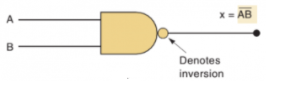
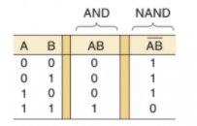


Logic Gates [Contd. . ]
5. NAND Gate: Expression:
Symbol: Truth Table of NOR Gate

Slide 12

Logic Gates [Contd. . ]
6. XOR Gate: Expression: x =
Symbol: Truth Table of XOR Gate
x
INPUT |  | OUTPUT
A | B | A XOR B
0 | 0 | 0
0 | 1 | 1
1 | 0 | 1
1 | 1 | 0

Slide 13

Logic Gates [Contd. . ]
7. XNOR Gate: Expression: x =
Symbol: Truth Table of XOR Gate
x
Input |  | Output
A | B | A XNOR B
0 | 0 | 1
0 | 1 | 0
1 | 0 | 0
1 | 1 | 1

Slide 14

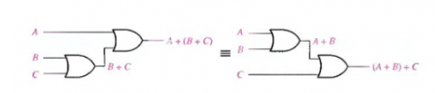
Laws and Rules of Boolean Algebra
Basic Laws:
Commutative Law : A+B = B+A
Associative Law : A+ (B+C) = (A+B)+C

Slide 15
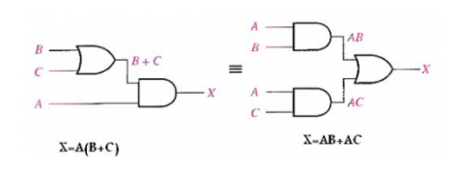
Laws and Rules of Boolean Algebra
Basic Laws:
3. Distributive Law: A (B+C) = AB+ AC

Slide 16
Laws and Rules of Boolean Algebra
Basic Laws:
4. Duality Property
- Duals are just the opposites of original operators
- Switching Logic depends upon Duality property b/w AND and OR operators
Eg: Operator Dual
AND OR
OR AND
0 1
1 0

Slide 17
Laws and Rules of Boolean Algebra
Basic Laws:
5. Idempotency Property
- Idempotency refers to “sameness”
Hence, x + x = x
x.x = x

Slide 18
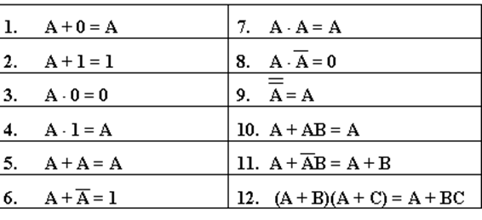
Laws and Rules of Boolean Algebra
12 Basic Rules of Boolean Algebra

Slide 19
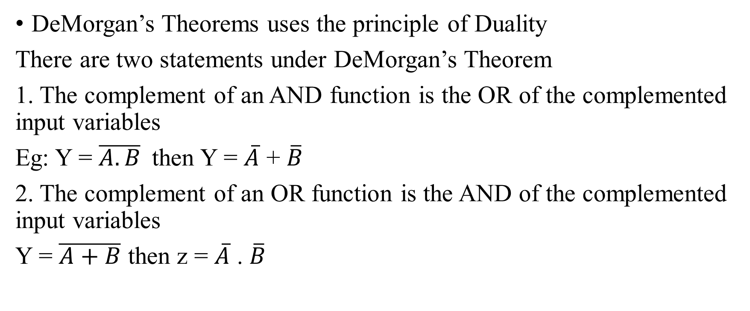
DeMorgan’s Theorems
DeMorgan’s Theorems uses the principle of Duality
There are two statements under DeMorgan’s Theorem
1. The complement of an AND function is the OR of the complemented input variables
Eg: Y = $\overline{A.B}$then Y = $\overline{A}$ + $\overline{B}$
2. The complement of an OR function is the AND of the complemented input variables
Y = $\overline{A+B}$ then z = $\overline{A}$ . $\overline{B}$

Slide 20




Reduction of Switching Equations using Boolean Algebra
Ex 1.

Slide 21
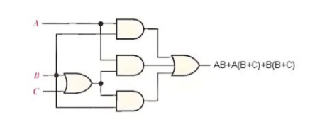

Realization of Switching Functions
Eg: AB + A(B + C) + B(B + C)
AB + AB + AC + BB + BC
Since, (BB = B) to the fourth term
AB + AB + AC + B + BC
Since (AB + AB = AB) to the first two terms.
AB + AC + B + BC
Since (B + BC = B) to the last two terms
AB + AC + B
(AB + B = B) to the first and third terms
→ B+AC

Slide 22
Definition of combinational Logic
There are two types of logic networks
Combinational network
Sequential networks

Slide 23
Combinational Logic Network
It is a technique of combining the basic gates into circuits that perform some desired function.
These circuits will not exhibit “Memory”
Output of the system depends on the present input
Eg: Adders, Subtractors, Decoders, Encoders, Multipliers
Combinational Logic Diagram:
Combinational Logic Function
y₀
x₀
Outputs
Inputs
x_{n}
y_{m}

Slide 24
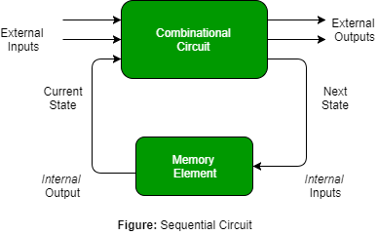
Sequential Networks
These networks exhibit a “Memory”
i.e. The Output is characterized by the combination of present input and also depends upon on the past history of the input
Eg: Flip flops
Sequential Logic Diagram:

Slide 25
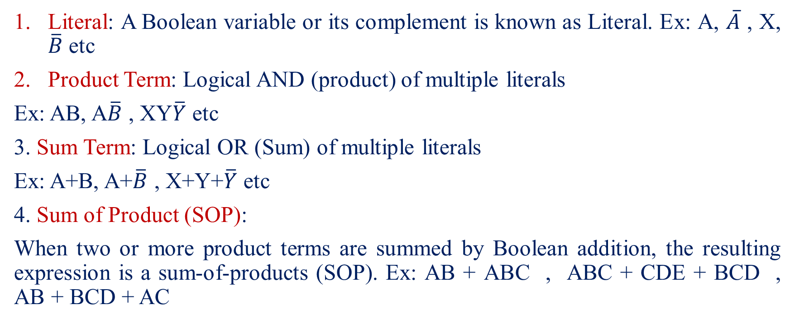
Important Terminologies
Literal: A Boolean variable or its complement is known as Literal. Ex: A, $\overline{A}$ , X, $\overline{B}$ etc
Product Term: Logical AND (product) of multiple literals
Ex: AB, A$\overline{B}$ , XY$\overline{Y}$ etc
3. Sum Term: Logical OR (Sum) of multiple literals
Ex: A+B, A+$\overline{B}$ , X+Y+$\overline{Y}$ etc
4. Sum of Product (SOP):
When two or more product terms are summed by Boolean addition, the resulting expression is a sum-of-products (SOP). Ex: AB + ABC , ABC + CDE + BCD , AB + BCD + AC

Slide 26

Important Terminologies (Contd..)
5. Product-of-sums (POS) When two or more sum terms are multiplied, the resulting expression is a product-of-sums
Ex:
6. Minterms: It is a product of ‘n’ variables in which each appears exactly once in true or complemented form.
7. Maxterms: It is a sum of the ‘n’ variables in which each appears exactly once in true or complemented form.

Slide 27
Important Terminologies (Contd..)
Minterms | Maxterms
Input variable is complemented when it has a value “0” in the Truth Table | Input variable is complemented when it has a value “1” in the Truth Table
Denoted by ‘m’ | Denoted by ‘M’
Reprsented as SOP form | Represented as POS form

Slide 28
Canonical Form
Canonical expressions are not simplified form
These contain redundancies
Canonical sum of Products: It is a complete set of Minterms that define when an output variable is logical 1.
Ex: a’bc+ab’c+abc’
Canonical Product-of-sums: : It is a complete set of Maxterms that define when an output variable is logical 0.
Ex: (a+b+c) (a’+b+c) (a+b’+c)

Slide 29
Canonical Form
Input Variable |  |  | Minterm |  | Maxterm
a | b | c | Term | Designation | Term | Designation
0 | 0 | 0 | a’b’c’ | m₀ | a+b+c | M₀
0 | 0 | 1 | a’b’c | m₁ | a+b+c’ | M₁
0 | 1 | 0 | a’bc’ | m₂ | a+b’+c | M₂
0 | 1 | 1 | ab’c’ | m₃ | a’+b+c | M₃
1 | 0 | 0 | a’bc | m₄ | a+b’+c’ | M₄
1 | 0 | 1 | ab’c | m₅ | a’+b+c’ | M₅
1 | 1 | 0 | abc’ | m₆ | a’+b’+c | M₆
1 | 1 | 1 | abc | m₇ | a’+b’+c’ | M₇

Slide 30
Steps to convert SOP to Canonical Form
Identifying the missing variable(s) in each AND term
AND the missing term and its complement with the original AND term, xy(z+z’) since (z+z’ ) = 1
Apply the distribution property and expand the term
i.e. xyz + xyz’
Steps to convert POS to Canonical Form
Identifying the missing variable(s) in each OR term
OR the missing term and its complement with the original OR term, x+y’+zz’ since (zz’ = 0)
Apply the distribution property and expand the term
i.e. (x+y’+z) (x+y’+z’)

Slide 31
Numerical on Canonical Form
Place the following equations into the proper canonical form
P = f(a,b,c) = ab’+ac’+bc
Soln: First term, AND (c+c’) with ab’: ab’(c+c’) = ab’c+ab’c’
Second Term, AND (b+b’) with ac’ : ac’(b+b’) = abc’+ab’c’
Third Term, AND (a+a’) with bc : abc + a’bc
→ P = ab’c+ab’c’ + abc’+ab’c’ + abc + a’bc
P = ab’c+ ab’c’ + abc’+ abc + a’bc
2. G = f(w,x,y,z) = w’x+yz’ ----- Try it !!

Slide 32
Numerical on Canonical Form
3. T = f(a,b,c) = (a+b’)(b’+c) ----- (POS Equn)
Soln:
First term, OR cc’ with (a+b’) = (a+b’+c) (a+b’+c’)
Second Term, OR aa’ with (b’+c) = (a+b’+c) (a’+b’+c)
→ T = f(a,b,c) = (a+b’+c) (a+b’+c’) (a’+b’+c)
4. J = f(A,B,C,D) = (A+B’+D)(A+B’+C) ---- Try it !!

Slide 33
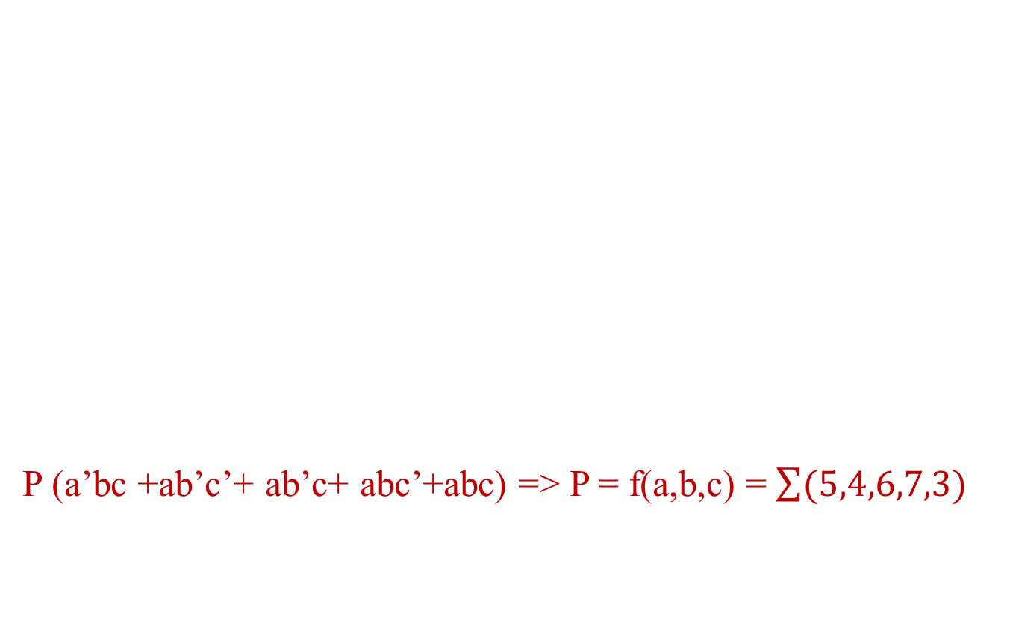
Generation of Switching Equations from Truth Table
Input Variable |  |  | Output Variable
a | b | c | Y
0 | 0 | 0 | 0
0 | 0 | 1 | 0
0 | 1 | 0 | 0
0 | 1 | 1 | 1
1 | 0 | 0 | 1
1 | 0 | 1 | 1
1 | 1 | 0 | 1
1 | 1 | 1 | 1
P (a’bc +ab’c’+ ab’c+ abc’+abc) => P = f(a,b,c) = $\sum{(5,4,6,7,3)}$

Slide 34
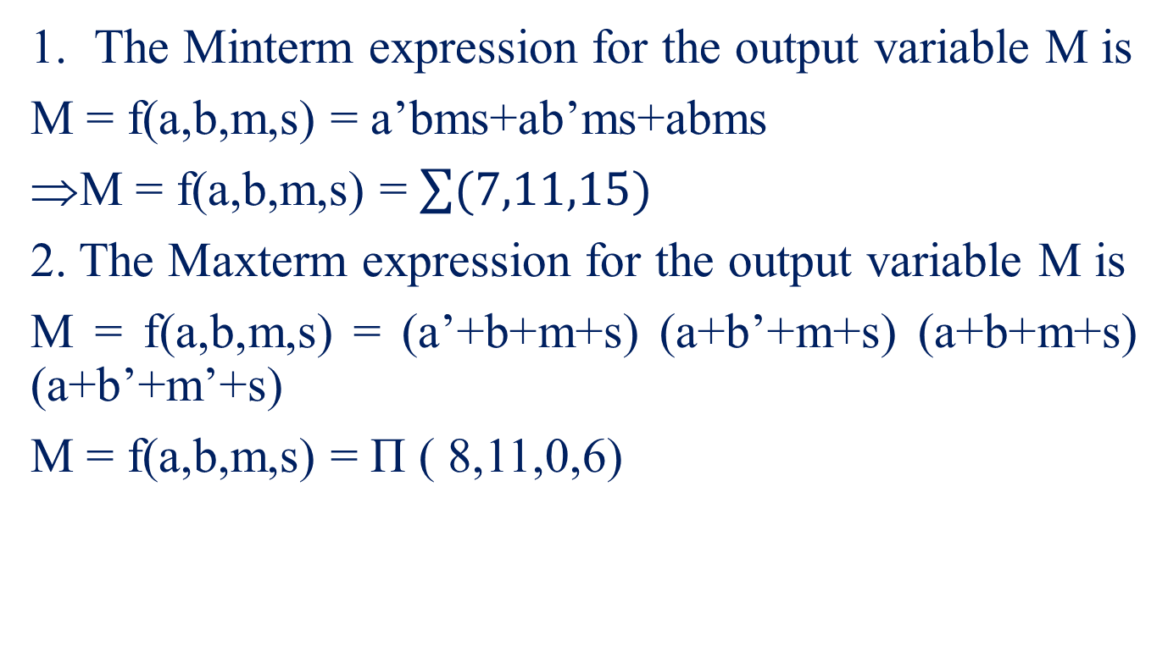
Numerical examples on Switching Equations from Truth Table

Slide 35
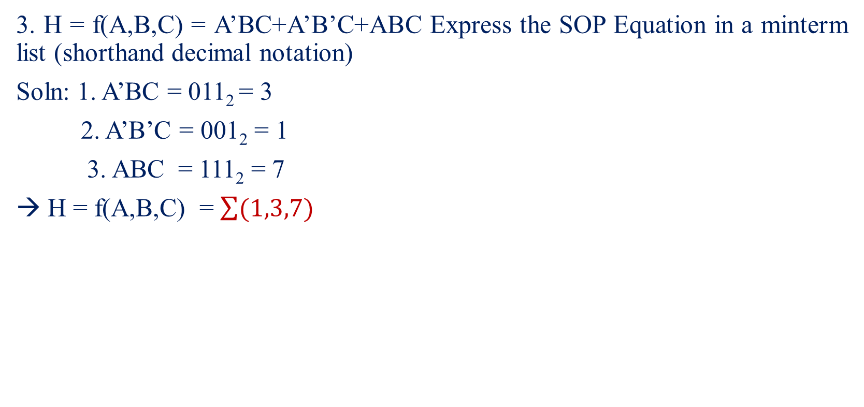
Numerical examples on Switching Equations from Truth Table

Slide 36
Introduction to Karnaugh-Maps
Karnaugh Maps offer a graphical method of reducing a digital circuit to its minimum number of gates
It is a Matrix of Squares
Each square represents a “cell” containing Minterms or Maxterm from a Boolean equation
K-Maps allows Identification of input variables and helps to reduce the output equation
The Karnaugh map can be populated with data from either a truth table or a Boolean equation.

Slide 37
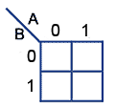
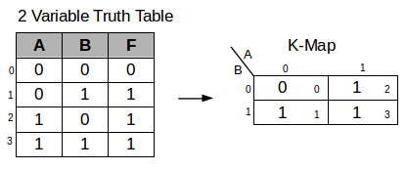
Types of K-Maps
Circuits with 2 inputs A and B require maps with 2² = 4 cells
Circuits with 3 inputs A B and C require maps with 2³ = 8 cells
Circuits with 4 inputs A B C and D require maps with 2⁴ = 16 cells
2 Variable K-Map

Slide 38
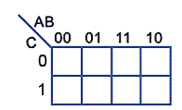
Types of K-Maps
3 Variable K-Map
Input Variable binary weighting
MSB LSB
A B C
Note:
Edge numbering does not follow the normal binary counting sequence.
It uses a Gray Code sequence where only one bit changes from one cell to the next.
0
2
6
4
1
3
7
5

Slide 39
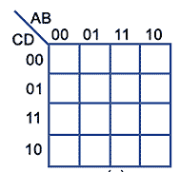
Types of K-Maps
4 Variable K-Map
Input Variable binary weighting
MSB LSB
A B C D
Note:
Edge numbering does not follow the normal binary counting sequence.
It uses a Gray Code sequence where only one bit changes from one cell to the next.
0
4
12
8
1
5
13
9
3
7
15
11
2
6
14
10

Slide 40
Rules of Cell Grouping in K-Maps
Groups should contain as many ‘1’ cells (i.e. cells containing a logic 1) as possible and no blank cells.
Groups can only contain 1, 2, 4, 8, 16 or 32... etc. cells (powers of 2).
A ‘1’ cell can only be grouped with adjacent ‘1’ cells that are immediately above, below, left or right of that cell; no diagonal grouping.
Groups of ‘1’ cells can overlap. This helps make smaller groups as large as possible, which is an advantage in finding the simplest solution.
The top/bottom and left/right edges of the map are considered to be continuous, so larger groups can be made by grouping cells across the top and bottom or left and right edges of the map
There should be as few groups as possible.

Slide 41
PI and EPI
Prime Implicants (PI): Group of Minterms that can be combined with any other Minterms or groups
Essential Prime Implicants (EPI): It is a PI in which one or more Minterms are unique.

Slide 42
THANK YOU

